Slide 1


Instagram Fake vs Genuine Account Analysis
Name: Gowri Priya
Tools : Power BI
Domain: Data Analyst

Slide 2
Project Overview
Developed an interactive dashboard to analyze Instagram accounts.
Objective: Identify patterns that distinguish fake/spammer accounts from genuine ones.
Used machine learning and data analytics techniques to derive actionable insights.

Slide 3
Objective
Detect and differentiate between fake and genuine Instagram accounts.
Build a dashboard that helps visualize behavioral and metadata patterns like:
Number of followers/following
Profile picture presence
Bio description length
Account privacy

Slide 4
Data Description
Source: Crawled dataset of Instagram accounts (March 2019).
Size: 576 entries, 12 features + target label (fake/genuine).
Key Features:
profile_pic, #followers, #follows, #posts
description length, private, external URL
name == username, nums/length username/fullname

Slide 5
Tools & Technologies
Power BI: Data visualization and dashboard creation.
Python (pandas, seaborn, sklearn): Data preprocessing, modeling.
Excel: Initial data inspection.
ML Model Used: Random Forest, Decision Tree

Slide 6
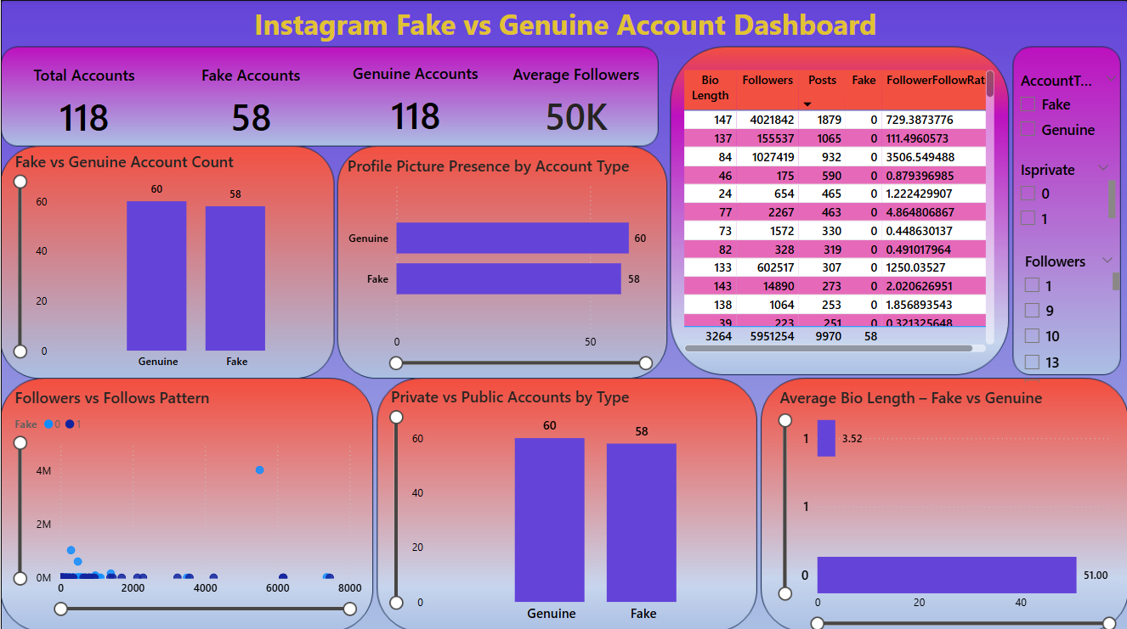

Slide 7
Dashboard Overview
Visuals Created:
Distribution of fake vs genuine accounts
Profile picture presence analysis
Followers/Following/Posts comparison
Correlation heatmap
Key Insight: Fake accounts typically have no profile picture, low/high follower anomalies, and short bios.

Slide 8
Challenges & Solutions
Challange | Solution
Missing/inconsistent data | Imputed missing values or removed rows
Imbalanced dataset (Fake = Genuine = 288) | Used balanced data & validation metrics
Feature Engineering for ML | Scaled numerical features, dropped IDs

Slide 9
Findings & Insights
Profile Picture: Majority of fake accounts lack a profile picture, unlike genuine ones.
Followers/Following: Fake accounts show abnormal ratios – often low followers but high following.
Bio Description: Fake users typically have short or empty bios.
Username Patterns: More numbers and auto-generated looking usernames seen in fake accounts.
Post Count: Genuine accounts have higher post activity.
Key Predictive Features: profile_pic, #followers, #follows, and description length.
Model Accuracy: Achieved 94% accuracy using Random Forest, showing strong performance.

Slide 10
Model Evaluation
Model Accuracy:
94.1%
Confusion Matrix:
True Positives (Fake): 56
True Negatives (Genuine): 57
F1-Score:
0.94 (macro avg)
Most Important Features:
profile_pic, #followers, #follows, username pattern

Slide 11
Conclusion
Created an accurate and visually insightful dashboard.
Successfully differentiated fake from genuine Instagram accounts.
Enabled stakeholders to understand key metrics leading to suspicious account behavior.

